Slide 1
VISUALIZATION Assignment (PART 3)
File created on: 6/9/2022 2:45:50 PM Tableau Public Dashboard Link -
https://public.tableau.com/app/profile/sana.tahasildar

Slide 2
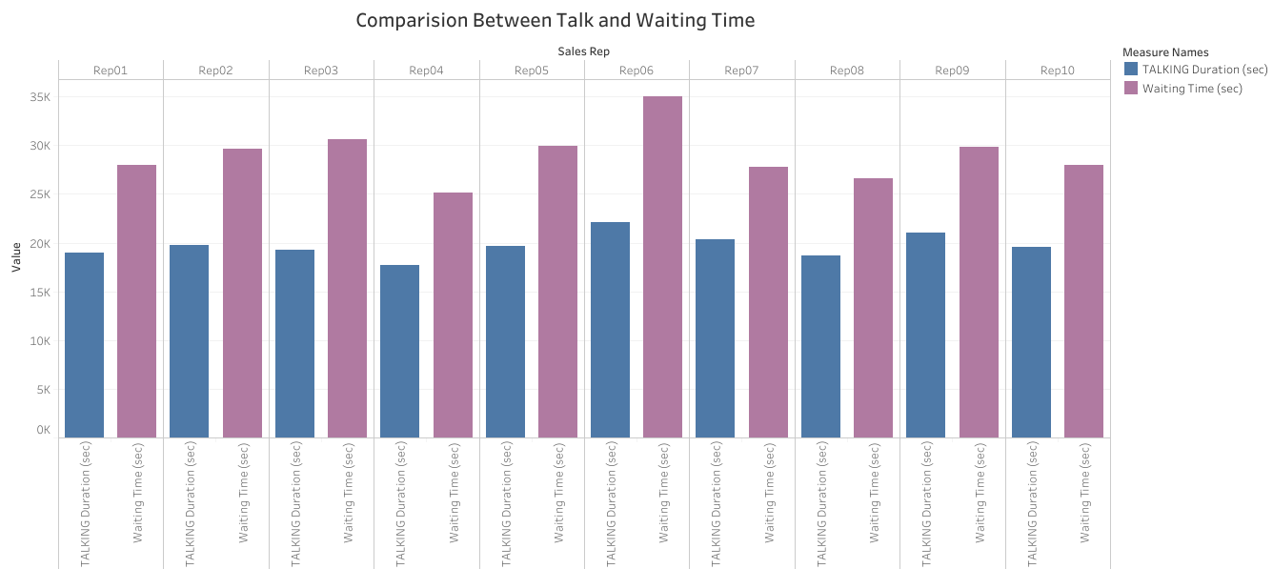

Slide 3
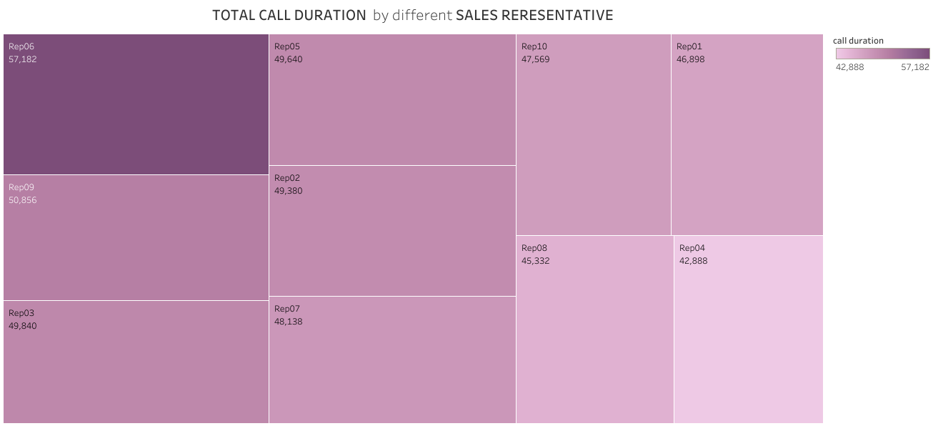

Slide 4
